Slide 1
Gustav Stresemann
Thursday 16th June 2011

Slide 2
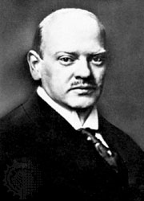
Enter: Gustav Stresemann
After 1924, a politician named Gustav Stresemann led the government (he became Chancellor in August 1923).
At first he had opposed the Weimar Republic, but changed when he realised the alternative was anarchy.

Slide 3
Streseman’s Achievements
DIFFERS
Dawes Plan, 1924
Inflation controlled, November 1923
French leave the Ruhr, April 1924
Foreign Affairs
Economic Growth
Reforms
Strength at the Centre

Slide 4
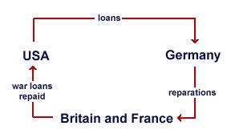
Dawes Plan 1924
Stresemann called off the 1923 Ruhr strike and started to pay reparations again – but the American Dawes Plan gave Germany longer to make the payments (and the Young Plan of 1929 reduced the payments).

Slide 5
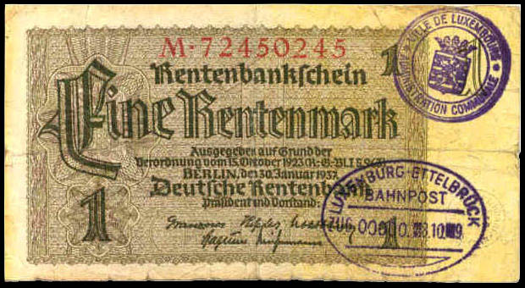
Inflation controlled, Nov 1923
Stresemann called in all the old, worthless marks (due to HYPERINFLATION) and burned them. He replaced them with a new Rentenmark (worth 3,000 million old marks). This stabilised inflation.

Slide 6
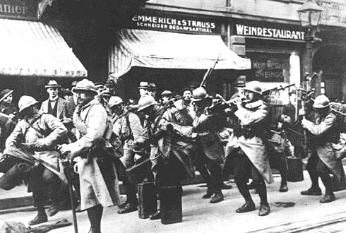
French leave the Ruhr, April 1924
Stresemann persuaded the French to leave.

Slide 7
Foreign Affairs
In 1925, Stresemann signed the Locarno Treaty, agreeing to the loss of Alsace-Lorraine. In 1926, Germany was allowed to join the League of Nations. Germany had become a world power again.
Source A
Stresemann ... worked hard to rebuild his shattered country and for peace and co-operation abroad. Because of his leadership Germany is now prospering and has an important place in the affairs of Europe.
from The Times, 4 October 1929.
An account of his life and achievements which was written just after his death.

Slide 8
Economic Growth
Germany borrowed 25,000 million gold marks, mainly from America. This was used to build roads, railways and factories. The economy boomed and led to prosperity. Cultural life also boomed (the Roaring Twenties).
Source B
The German economy is doing well only on the surface. Germany is in fact dancing on a volcano. If the short-term loans are called in by America, most of our economy will collapse.
from a speech made by Gustav Stresemann shortly before his death on 3 October 1929

Slide 9
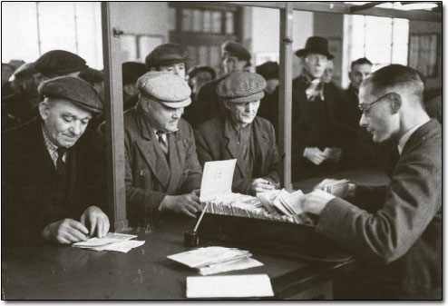
Reforms
Stresemann introduced reforms to make life better for the working classes - Labour Exchanges (1927) and unemployment pay. Also, 3 million new houses were built.

Slide 10
Strength at the Centre
Stresemann arranged a 'Great Coalition' of the moderate pro-democracy parties (based around the SDP, the Centre party and Stresemann's own 'German people's Party', the DVP).
United together, they were able to resist the criticism from smaller extremist parties, and in this way, he overcame the effects of proportional representation - the government had enough members of the Reichstag supporting it to pass the laws it needed.

Slide 11
Which of Stresemann’s actions was the most significant in helping the Weimar Republic to survive?
Rank his actions in order of significance (1-7).
Which is the most significant?
Why?
Why this action over the others?
BE PREPARED TO EXPLAIN TO CLASS!!!
Dawes Plan, 1924
Inflation controlled, November 1923
French leave the Ruhr, April 1924
Foreign Affairs
Economic Growth
Reforms
Strength at the Centre

Slide 12


Debate
With political pundits…
Christopher Dunn
Andrew Wileman
Harrison Rees
Ethan Ming
Jake Hill
Stephen Smith
Sean Lamb
What was the best thing Stresemann ever did for us?

Slide 13

Homework
How did Stresemann “save” the Weimar Republic?
i.e. Mention ALL 7 of Streseman’s actions.

